Slide 1

HTML 5
What is HTML?
HTML stands - Hyper Text Markup Language
It helps to creating Web pages
It describes the structure of a Web page
It consists of a series of elements
It helps how to display the content

Slide 2
HTML 5
A Simple HTML Document
Example
<!DOCTYPE html>
<html>
<head>
<title>Page Title</title>
</head>
<body>
<h1>My First Heading</h1>
<p>My first paragraph.</p>
</body>
</html>
Notes:
Ref : doc.html -> 2 to 17

Slide 3
HTML 5
What is an HTML Element?
An HTML element is defined by a start tag, some content, and an end tag:
<tagname> Content goes here... </tagname>
Example :
<h1>My First Heading</h1>
Start tag | Element content | End tag
<h1> | My First Heading | </h1>
<p> | My first paragraph. | </p>
<br> | none | none

Slide 4
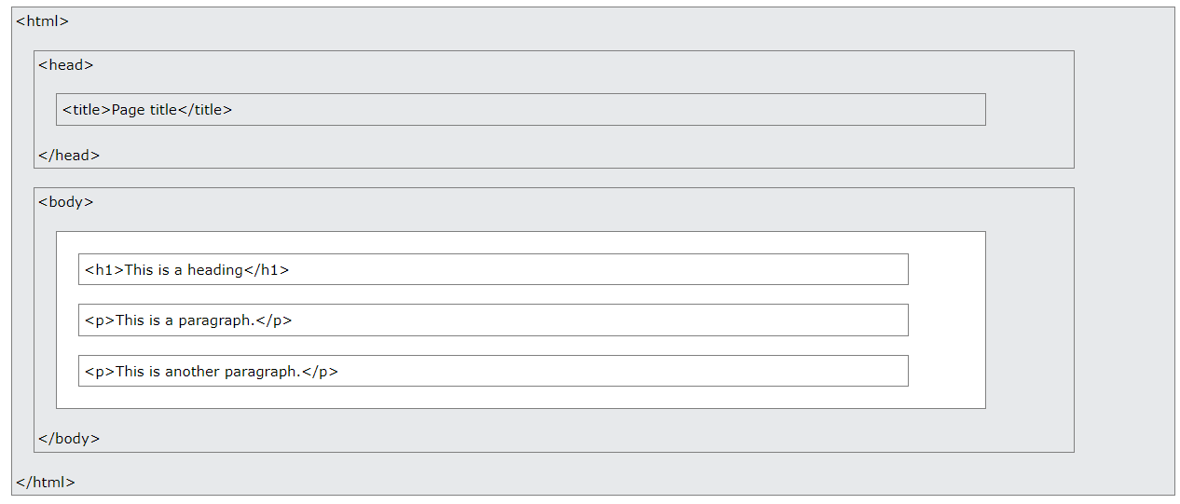
HTML 5
HTML Page Structure
Below is a visualization of an HTML page structure:

Slide 5
HTML 5
HTML Elements?
HTML elements with no content are called empty elements.
The <br> tag defines a line break, and is an empty element without a closing tag.
Example :
<p>This is a <br> paragraph with a line break.</p>

Slide 6
HTML 5
HTML Attributes
All HTML elements can have attributes
Attributes provide additional information about elements
Attributes are always specified in the start tag
Attributes usually come in name/value pairs like: name="value“
Notes:
Ref : doc.html -> 21 to 53

Slide 7
HTML 5
HTML Headings
Heading 1 - <h1>
Heading 2 - <h2>
Heading 3 - <h3>
Heading 4 - <h4>
Heading 5 - <h5>
Heading 6 - <h6>
Notes:
Ref : doc.html -> 21 to 53

Slide 8
HTML 5
HTML Paragraphs
A paragraph always starts on a new line
<p> tag element defines a paragraph
Browsers automatically add some white space (a margin) before and after a paragraph.
Example
<p>This is a paragraph.</p>
<p>This is another paragraph.</p>
Notes:
Ref : doc.html -> 77 to 150

Slide 9
HTML 5
HTML Styles
The html style attribute is used to add styles to an element, such as color, font, size, and more.
Example :
<p style="color:red;">I am red</p>
<p style="color:blue;">I am blue</p>
<p style="font-size:50px;">I am big</p>
Notes:
Ref : doc.html -> 154 to 188

Slide 10
HTML 5
HTML Formatting Elements
Formatting elements were designed to display special types of text:
<b> - Bold text
<strong> - Important text
<i> - Italic text
<em> - Emphasized text
<mark> - Marked text
<small> - Smaller text
<del> - Deleted text
<ins> - Inserted text
<sub> - Subscript text
<sup> - Superscript text

Slide 11
HTML 5
HTML Comments
You can add comments to your HTML source by using the following syntax:
<!-- Write your comments here -->
HTML Quotation and Citation Elements
Examples :
<blockquote>,<q>, <abbr>, <address>, <cite>, and <bdo>
Notes:
Ref : doc.html -> 180 to 229

Slide 12
HTML 5
HTML Colours
Background Colour
Text Colour
Border Colour
Colour Values
RGB
HEX
HSL
Notes:
Ref : doc.html -> 234 to 258

Slide 13
HTML 5
HTML Links
HTML links are hyperlinks.
<a href="url">link text</a>
HTML Links - The target Attribute
_self - Default. Opens the document in the same window/tab as it was clicked
_blank - Opens the document in a new window or tab
_parent - Opens the document in the parent frame
_top - Opens the document in the full body of the window
Ex : <a href="https://www.faceprep.in/" target="_blank">click here</a>
Notes:
Ref : doc.html -> 262 to 290

Slide 14
HTML 5
HTML Images Syntax
The HTML <img> tag is used to embed an image in a web page.
The <img> tag is empty, it contains attributes only, and does not have a closing tag.
The <img> tag has two required attributes:
src - Specifies the path to the image
alt - Specifies an alternate text for the image
Syntax
<img src="url" alt="alternatetext">
Notes:
Ref : doc.html -> 294 to 405

Slide 15

HTML 5
HTML Favicon
A favicon is a small image displayed next to the page title in the browser tab.
How To Add a Favicon in HTML :
<head>
<title>My Page Title</title>
<link rel="icon" type="image/x-icon" href="/images/favicon.ico">
</head>
Notes:
Ref : doc.html -> 408 to 430

Slide 16
HTML 5
HTML Page Title
Every web page should have a page title to describe the meaning of the page.
The <title> element adds a title to your page:
<!DOCTYPE html>
<html>
<head>
<title>HTML Tutorial</title>
</head>
<body>
Notes:
Ref : doc.html -> 434 to 442

Slide 17
HTML 5
HTML Tables
Table Cells & Rows
Table Borders
Table Sizes
Table Headers
Table Padding & Spacing
Table Colspan & Rowspan
Table Styling
Table Colgroup
Notes:
Ref : doc.html -> 447 to 1039

Slide 18
HTML 5
HTML Lists
HTML lists allow web developers to group a set of related items in lists.
Example
An unordered HTML list:
Item
Item
Item
Item
An ordered HTML list:
First item
Second item
Third item
Fourth item
Notes:
Ref : doc.html -> 1041 to 1188

Slide 19
HTML 5
HTML Block and Inline Elements
Block-level Elements
A block-level element always takes up the full width available (stretches out to the left and right as far as it can).
The <p> element defines a paragraph in an HTML document.
The <div> element defines a division or a section in an HTML document.
Inline Elements
An inline element does not start on a new line.
An inline element only takes up as much width as necessary.
This is a <span> element inside a paragraph.
Notes:
Ref : doc.html -> 1190 to 1219

Slide 20
HTML 5
HTML Div Element
The <div> element is used as a container for other HTML elements.
The <div> element is by default a block element, meaning that it takes all available width, and comes with line breaks before and after.
Flex
To make the CSS flex method work, surround the <div> elements with another <div> element and give it the status as a flex container.
Notes:
Ref : doc.html -> 1222 to 1291

Slide 21
HTML 5
HTML class Attribute
The HTML class attribute specifies one or more class names for an element
Classes are used by CSS and JavaScript to select and access specific elements
The class attribute can be used on any HTML element
The class name is case sensitive
Different HTML elements can point to the same class name
JavaScript can access elements with a specific class name with the getElementsByClassName() method
Notes:
Ref : doc.html -> 1295 to 1368

Slide 22
HTML 5
HTML id Attribute
The id attribute is used to specify a unique id for an HTML element
The value of the id attribute must be unique within the HTML document
The id attribute is used by CSS and JavaScript to style/select a specific element
The value of the id attribute is case sensitive
The id attribute is also used to create HTML bookmarks
JavaScript can access an element with a specific id with the getElementById() method
Notes:
Ref : doc.html -> 1371 to 1426

Slide 23
HTML 5
HTML Iframes
The HTML <iframe> tag specifies an inline frame
The src attribute defines the URL of the page to embed
Always include a title attribute (for screen readers)
The height and width attributes specify the size of the iframe
Use border:none; to remove the border around the iframe
Notes:
Ref : doc.html -> 1371 to 1463

Slide 24
HTML 5
HTML File Paths
Path | Description
<img src="picture.jpg"> | The "picture.jpg" file is located in the same folder as the current page
<img src="images/picture.jpg"> | The "picture.jpg" file is located in the images folder in the current folder
<img src="/images/picture.jpg"> | The "picture.jpg" file is located in the images folder at the root of the current web
<img src="../picture.jpg"> | The "picture.jpg" file is located in the folder one level up from the current folder

Slide 25
HTML 5
HTML - The Head Element
The <head> element is a container for metadata
The <head> element is placed between the <html> tag and the <body> tag
The <title> element is required and it defines the title of the document
The <style> element is used to define style information for a single document
The <link> tag is most often used to link to external style sheets
The <meta> element is typically used to specify the character set, page description, keywords, author of the document, and viewport settings
The <script> element is used to define client-side JavaScripts
The <base> element specifies the base URL and/or target for all relative URLs in a page
Notes:
Ref : doc.html -> 1466 to 1518

Slide 26
HTML 5
HTML Layout Elements
<header> - Defines a header for a document or a section
<nav> - Defines a set of navigation links
<section> - Defines a section in a document
<article> - Defines an independent, self-contained content
<aside> - Defines content aside from the content (like a sidebar)
<footer> - Defines a footer for a document or a section
<details> - Defines additional details that the user can open and close on demand
<summary> - Defines a heading for the <details> element
Notes:
Ref : doc.html -> 1522 to 1626

Slide 27
HTML 5
HTML Computer Code Elements
The <kbd> element defines keyboard input
The <samp> element defines sample output from a computer program
The <code> element defines a piece of computer code
The <var> element defines a variable in programming or in a mathematical expression
The <pre> element defines preformatted text
Notes:
Ref : doc.html -> 1629 to 1658

Slide 28
HTML 5
HTML Forms
An HTML form is used to collect user input. The user input is most often sent to a server for processing.
An <input> element can be displayed in many ways, depending on the type attribute.
Type | Description
<input type="text"> | Displays a single-line text input field
<input type="radio"> | Displays a radio button (for selecting one of many choices)
<input type="checkbox"> | Displays a checkbox (for selecting zero or more of many choices)
<input type="submit"> | Displays a submit button (for submitting the form)
<input type="button"> | Displays a clickable button
Notes:
Ref : doc.html -> 1662 to 1715

Slide 29
HTML 5
HTML Form Attributes
The action attribute defines the action to be performed when the form is submitted.
Usually, the form data is sent to a file on the server when the user clicks on the submit button.
Value | Description
_blank | The response is displayed in a new window or tab
_self | The response is displayed in the current window
_parent | The response is displayed in the parent frame
_top | The response is displayed in the full body of the window
framename | The response is displayed in a named iframe
Notes:
Ref : doc.html -> 1718 to 1773

Slide 30
HTML 5
HTML Form Elements
The HTML <form> element can contain one or more of the following form elements:
<input>
<label>
<select>
<textarea>
<button>
<legend>
<datalist>
<output>
<option>
Notes:
Ref : doc.html -> 1777 to 1877

Slide 31
HTML 5
HTML Input Types
Type 1 | Type 2 | Type 3
<input type="button"> | <input type="file"> | <input type="range">
<input type="checkbox"> | <input type="hidden"> | <input type="submit">
<input type="color"> | <input type="image"> | <input type="tel">
<input type="date"> | <input type="month"> | <input type="text">
<input type="search"> | <input type="number"> | <input type="time">
<input type="email"> | <input type="password"> | <input type="url">
input type="reset"> | <input type="radio"> | <input type="week">
Notes:
Ref : doc.html -> 1881 to 2094

Slide 32
HTML 5
HTML Input Attributes
Type 1 | Type 2
readonly Attribute | placeholder Attribute
disabled Attribute | required Attribute
size Attribute | pattern Attribute
maxlength Attribute | autofocus Attribute
min and max Attributes | height and width Attributes
multiple Attribute | list Attribute
value Attribute | autocomplete Attribute
Notes:
Ref : doc.html -> 2098 to 2284

Slide 33
HTML 5
HTML Video
Example
<video width="320" height="240" controls>
<source src="movie.mp4" type="video/mp4">
<source src="movie.ogg" type="video/ogg">
Your browser does not support the video tag.
</video>
HTML Audio
Example
<audio controls> <source src="horse.ogg" type="audio/ogg"> <source src="horse.mp3" type="audio/mpeg"> Your browser does not support the audio element. </audio>
Notes:
Ref : doc.html -> 1662 to 2327

Slide 34
HTML 5
Thank You
Notes:
Ref : doc.html -> 1662 to

